Slide 1


Introduction To
Data Science
Introduction To Data Science
“Hiding within those mounds of data is the knowledge that could change the life of a patient, or change the world”

Slide 2
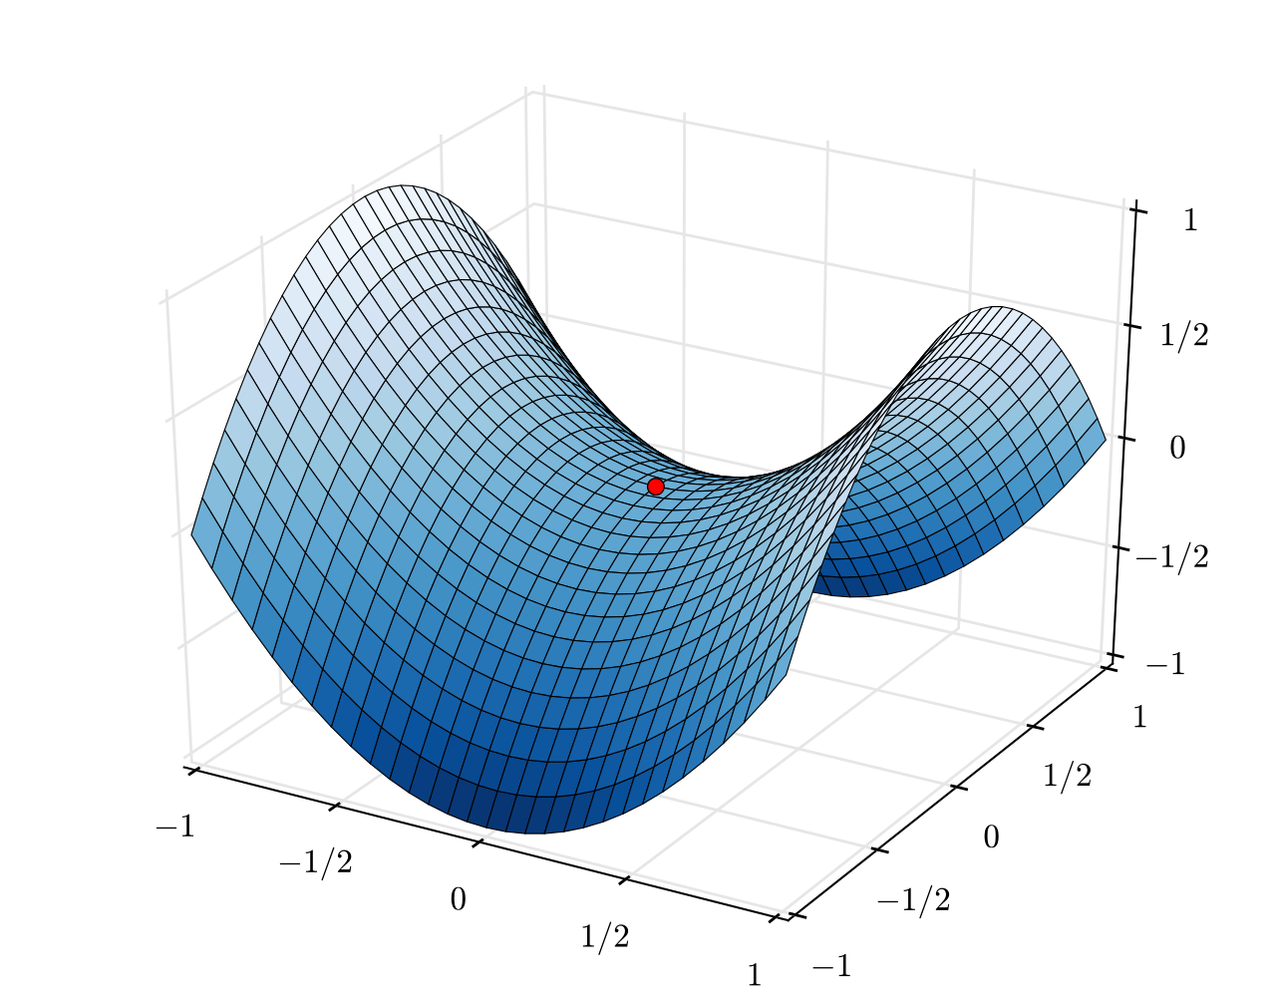
Gradient Decent
Introduction To Data Science
Principle of gradient descent for supervised learning Application to linear regression and logistic regression

Slide 3
Big data context - Data volume
Introduction To Data Science
Big data context: the size of the databases to be processed becomes an essential issue for machine learning algorithms
It is necessary to develop learning strategies that can handle large databases (especially in terms of number of descriptors)
By reducing the size of the data structures to be maintained in memory
While obtaining results of satisfactory quality (comparable to those produced by standard algorithms e.g., logistic regression)
Gradient descent (stochastic) is not a new concept (cf. ADALINE, 1960), but it is of great interest today, in particular for training deep neural networks (Deep Learning). It also allows to revisit existing statistical approaches (e.g., regression in this paper)

Slide 4
Gradient Algorithm
Introduction To Data Science
Iterative approach for the minimization of a function

Slide 5
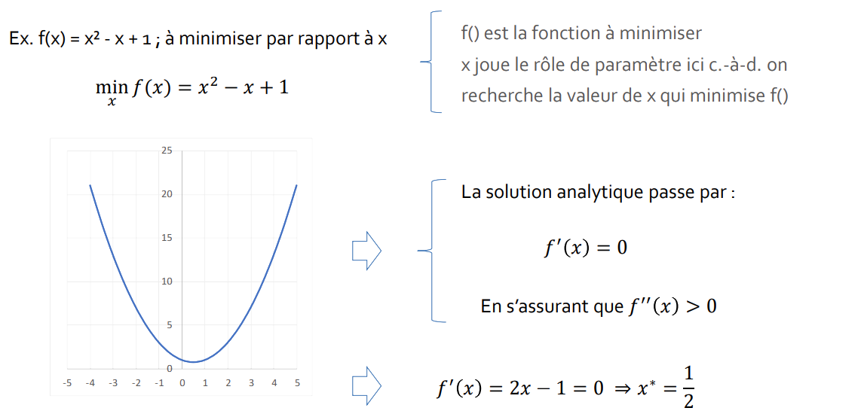
Optimization of a differentiable and convex function
Introduction To Data Science
Maximizing or minimizing a function is a common problem usual problem in many domains.
to be minimized with respect to x
f() is the function to minimize
x plays the role of a parameter here, i.e., we search for the value of x that minimizes f()
The analytical solution involves :
By ensuring that 𝑓′′ (𝑥) > 0

Slide 6
Gradient algorithm (gradient descent)
Introduction To Data Science
Sometimes the analytical solution is not possible, because the number of parameters is high for example, or because the or because the calculation would be too expensive to ➔ approximate with an iterative approach
Gradient algorithm
Almost impossible to suggest "smart" values intelligent" values
Initialize with x0 (Random)
Repeat
𝑥𝑡+1 = 𝑥𝑡 − 𝜂 × ∇𝑓(𝑥𝑡)
Until Convergence
The "gradient", a generalization multidimensional generalization of the derivative [if a single parameter], at point xt . Indicates the direction and the magnitude of the gradient in the vicinity of xt .
η is a parameter that allows to modulate the correction (η too low, slow convergence ; η too high, oscillation)
- because we want to minimize f(), otherwise we would take +.
Fixed number of iterations, or difference between successive values xt , or ||∇𝑓(𝑥𝑡)|| very small

Slide 7
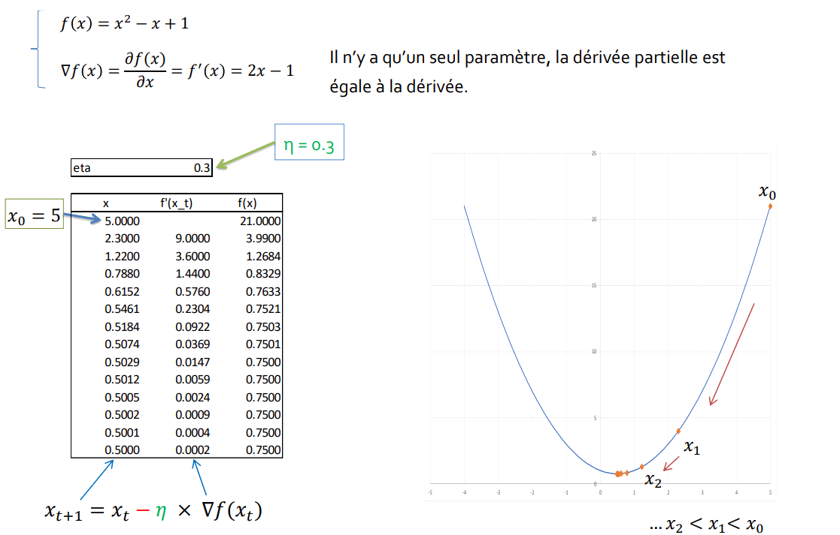
Gradient algorithm (Example)
Introduction To Data Science
There is only one parameter, the partial derivative is
equal to the derivative.

Slide 8
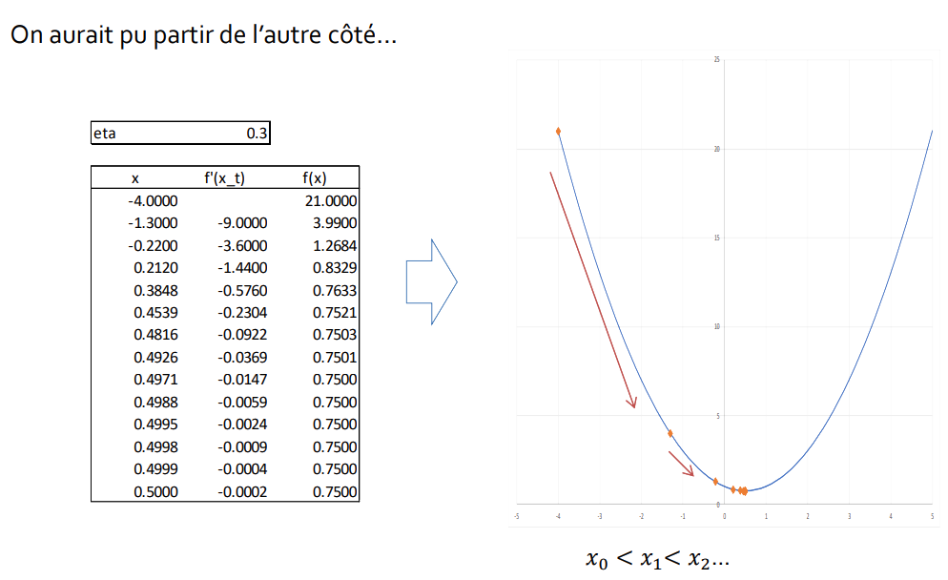
Gradient algorithm (Example)
Introduction To Data Science
We Could have gone the other way
what does this have to do with machine learning ?

Slide 9
Multiple Linear Regression
Introduction To Data Science
Application of gradient descent to multiple linear regression

Slide 10
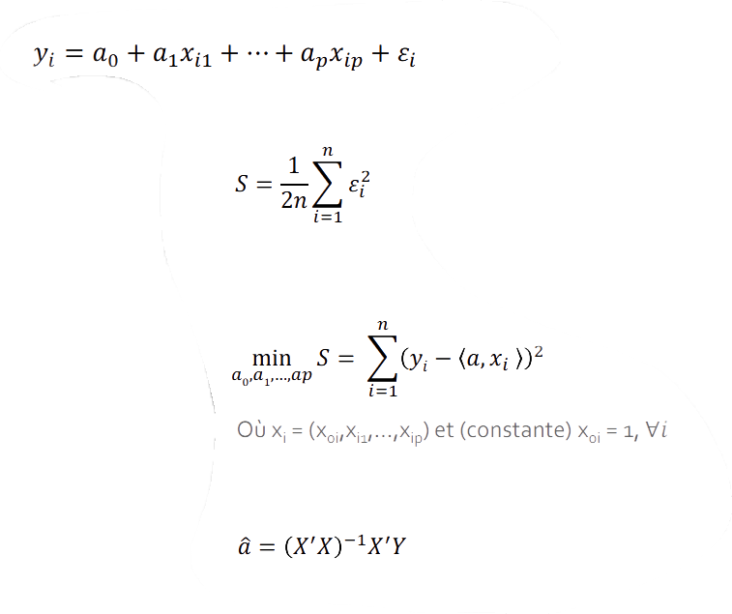
Multiple Linear Regression
Introduction To Data Science
Model y (quantitative) from p explanatory variables X = (x1 , x2, ..., xp) quantitative
On a sample of size n, we try to minimize the criterion
Least squares criterion
We have a problem of minimization problem with respect to the parameters 𝑎 = (𝑎0, 𝑎1, ⋯ , 𝑎𝑝)
There is an "exact" solution

Slide 11
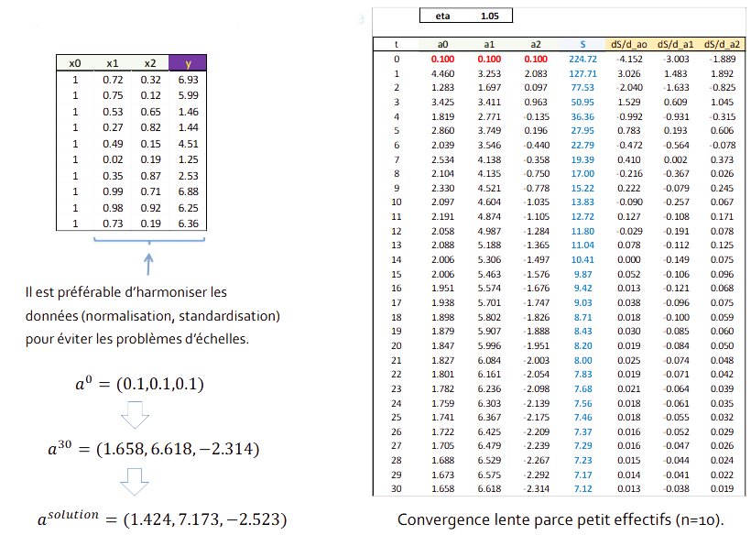
Multiple Linear Regression – Example
Introduction To Data Science
It is preferable to harmonize the data (normalization, standardization) to avoid problems of scale.
Slow convergence because of small numbers (n=10).

Slide 12
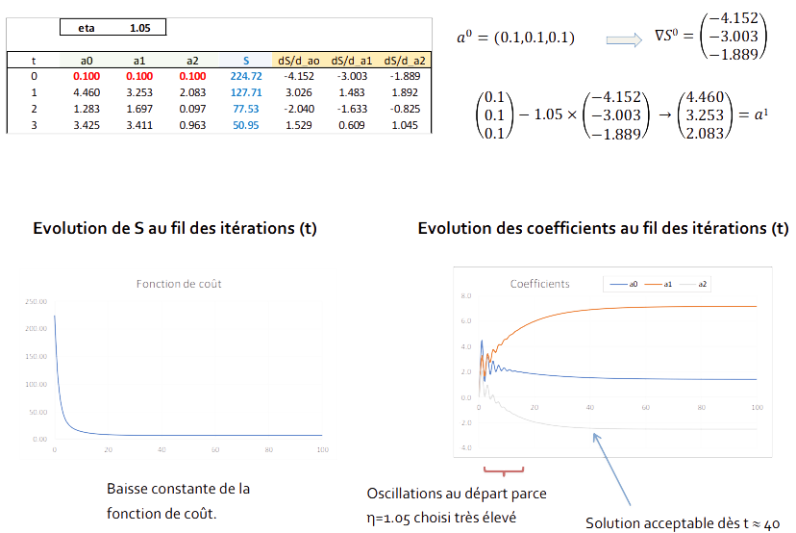
Multiple Linear Regression – Example
Introduction To Data Science
Evolution of S through the iterations (t)
Evolution of the coefficients through the iterations (t)
Constant decrease of the cost function.
Oscillations at the beginning because η=1.05 chosen very high
Acceptable solution starting from t ~ 40

Slide 13
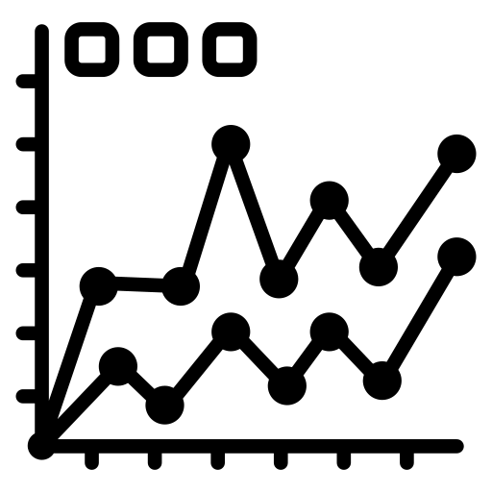
Stochastic Gradient Descent
Introduction To Data Science
Incremental approach for the processing of very large databases

Slide 14
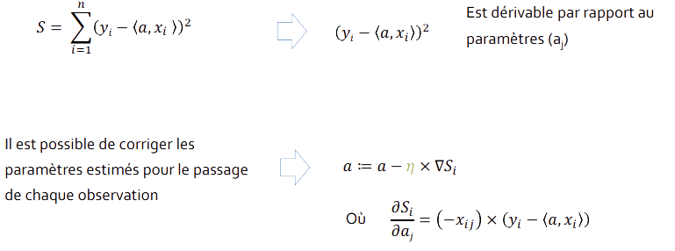
Correction by observation (online)
Introduction To Data Science
Stochastic gradient is an approximation of gradient descent, applicable when the objective function is written as a sum of derivable functions: this is very often the case very often the case in supervised learning (or it is arranged to be the case)
Example of linear multiple regression
via least squares
Is derivable with respect to the parameters (aj)
It is possible to correct the estimated parameters for the passage of each observation
Where

Slide 15
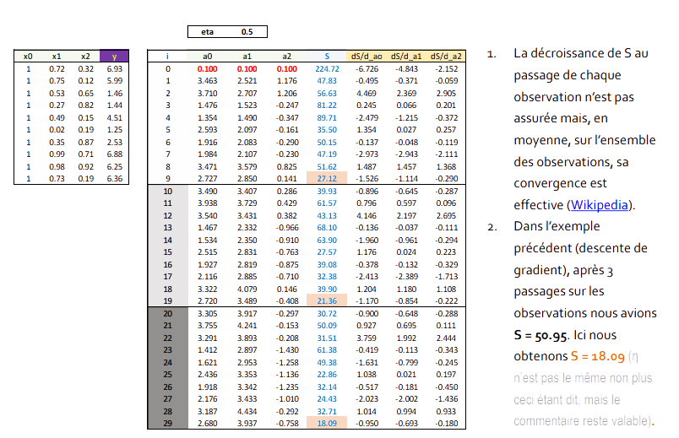
Correction by observation (online) Example
Introduction To Data Science
The decrease of S at the passage of each observation is not guaranteed but, on average, on the whole observations, its convergence is effective (Wikipedia).
In the example example (gradient descent) gradient), after 3 runs on the observations we had S = 50.95. Here we obtain S = 18.09 (that being said, η is not the same either, but the comment remains valid).

Slide 16
Strategies - Stochastic Gradient
Introduction To Data Science
1. Batch gradient descent. We run the whole set of observations observations, the gradient is calculated, the coefficients are corrected. Etc.
2. Online. Gradient computed for each observation, correction of the coefficients. Etc.
3. Mini-batch (batch processing). A group of observations (number of observations = parameter of the algorithm) is passed through. Calculation of the gradient. Correction of the coefficients. Etc.
Batch processing improves convergence by reducing the number of passes over the entire database.
It also makes it possible to be satisfied with partially loading the data in memory as we go along.

Slide 17

Choice Of Learning Rate
Introduction To Data Science
Fixed rate or decreasing rate over the learning process

Slide 18
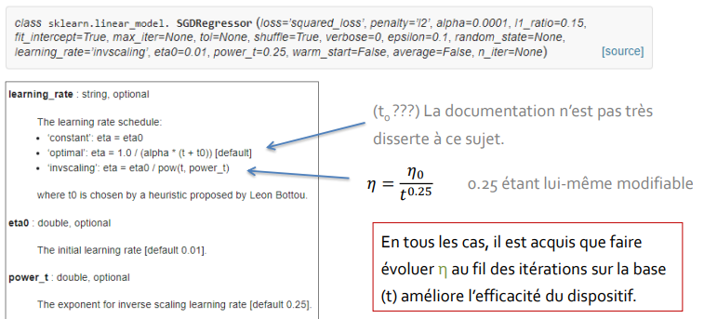
Importance of the learning rate
Introduction To Data Science
η determines the convergence speed of the learning process
Improve the device by evolving η over the iterations (strong at the beginning to accelerate convergence, weak at the end to improve accuracy)
Example : SGDRegressor from the ''scikit-learn'' package (Python)
(t0 ???) The documentation is not very dissertation on this subject.
0.25 being itself modifiable
In any case, it is a given that making evolve η over the iterations on the basis (t) improves the efficiency of the device.

Slide 19
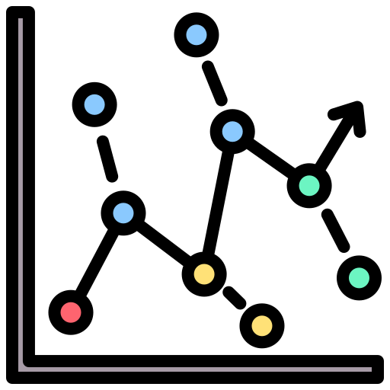
Logistic Regression
Introduction To Data Science
Application of gradient descent to logistic regression

Slide 20
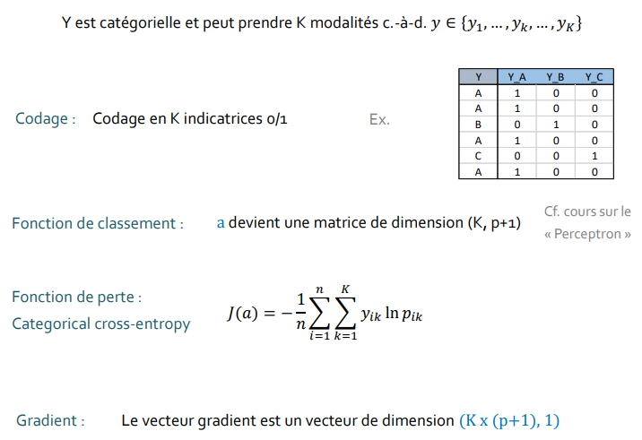
multinomial logistic regression
Introduction To Data Science
Y is categorical and can take K modalities c a d, 𝑦 ∈ {𝑦1, ... , 𝑦𝑘, ... , 𝑦K}
Coding: Coding in K indicators 0/1
See course on the
“Perceptron”
Ranking function : a becomes a matrix of dimension (K, p+1)
Loss function :
Categorical cross-entropy
Gradient: The gradient vector is a vector of dimension (K x (p+1), 1)

Slide 21

Software
Introduction To Data Science
Some packages for Python and R, among others....

Slide 22
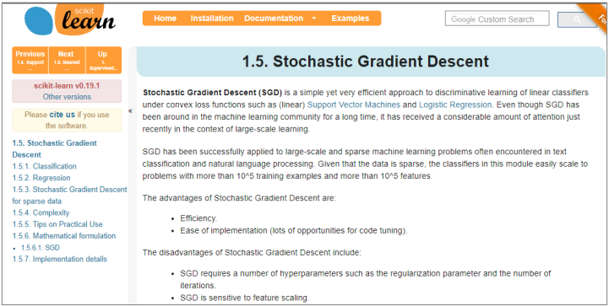
Python - "scikit-learn" library
Introduction To Data Science

Slide 23
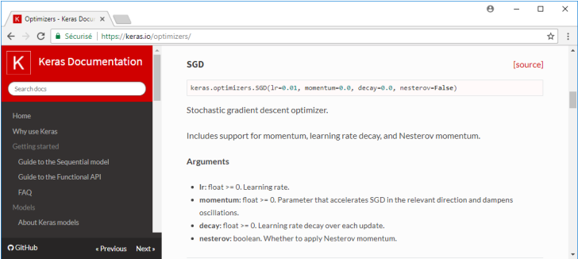
Python - “Tensorflow / Keras" library
Introduction To Data Science
"Stochastic gradient descent" is used - among others - for deep learning of deep neural networks (deep learning).

Slide 24
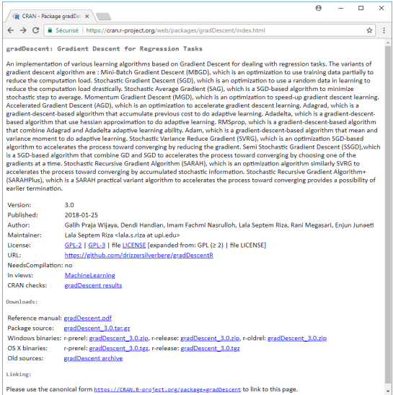
R – Library « gradDescent », and others…
Introduction To Data Science
And all those who implement the neural networks neural networks whose simple and multilayer perceptrons (e.g., Tensorflow / Keras, nnet, etc.) and which rely on gradient descent (stochastic) gradient descent.

Slide 25
Conclusion
Introduction To Data Science

Slide 26
Strategies - Stochastic Gradient
Introduction To Data Science
Why Gradient Descent for Supervised Learning?
Classical approaches and especially implementations of data mining methods are powerless against very large volumes
The gradient / stochastic gradient algorithm allows to apprehend them without requiring prohibitive machine resources
Possibility of parallelization of the algorithms
Be careful though...
A large number of parameters that are not always easy to understand and that influence the behaviour of the algorithm
Always bring the variables on the same scale (normalization, standardization) to avoid that disparities distort the optimization process

